Slide 1

2D Ising Model
Monte Carlo simulations

Slide 2





Content
Introduction and Background
Ferromagnets
Monte Carlo Simulation
Metropolis algorithm
Results and discussion
Conclusion and further applications
References and source code

Slide 3


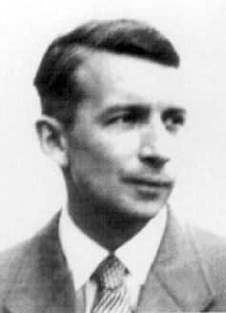
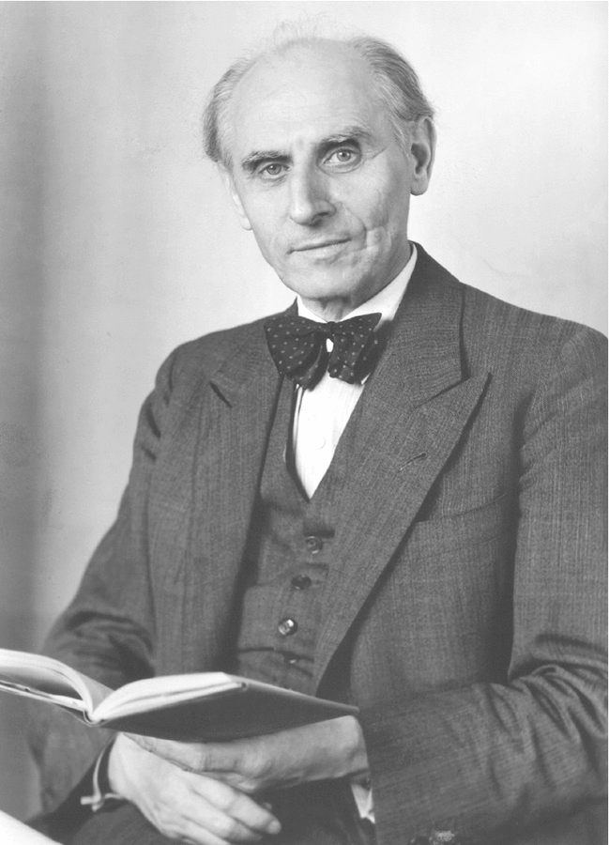

Introduction and Background
In 1920 Wilhelm Lens gave a problem to his student Ernst Ising
German physicist
Prof. in
Hamburg University
German physicist
His doctoral thesis studied a problem suggested by his teacher

Slide 4



Introduction and Background
Problem description
a mathematical model of ferromagnetism in statistical mechanics.
A basic mechanism by which certain material form permanent magnets or attracted to magnets

Slide 5
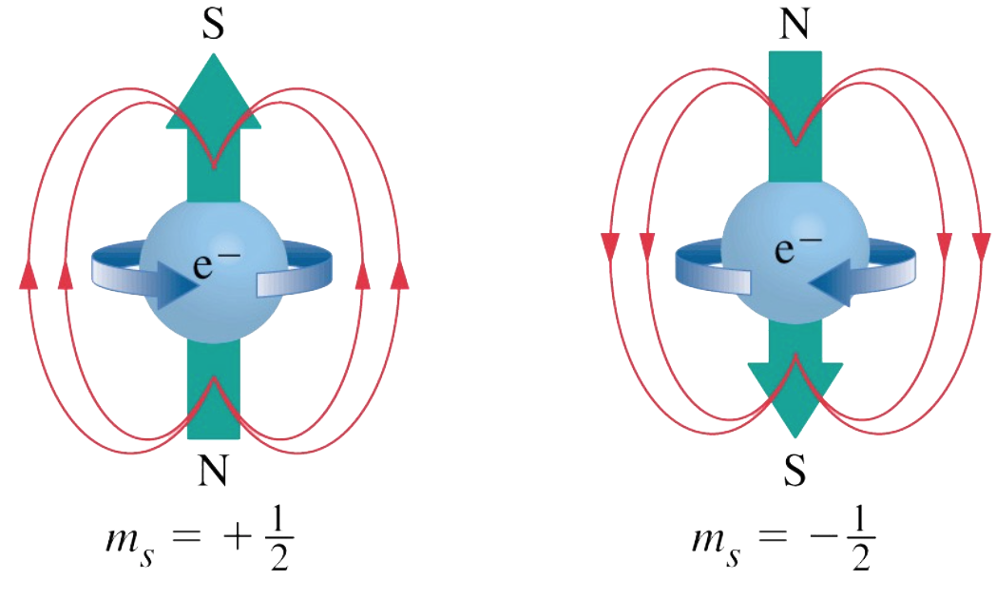
Introduction and Background
Problem description
The model consists of discrete variables that represent magnetic dipole moments of atomic "spins" that can be in one of two states (+1 or −1)
Ferromagnetism is explained by the concept that some species of atoms possess a magnetic moment such an atom itself is an elementary electromagnet produced by the motion of electrons about its nucleus and by the spin of its electrons on their own axes.

Slide 6
Introduction and Background
Problem description
A lattice (where the local structure repeats in all directions), allowing each spin to interact with its neighbors.

Slide 7
Introduction and Background
Problem description
Neighboring spins that agree have a lower energy than those that disagree
the system tends to the lowest energy, but heat disturbs this tendency.

Slide 8

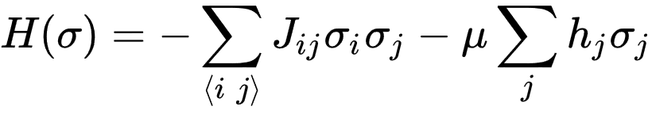
Introduction and Background
Problem description
The energy of a configuration σ is given by the Hamiltonian function
Configuration of 2 neighbor spins
The interaction coupling constant
The energy of a configuration
External magnetic field

Slide 9
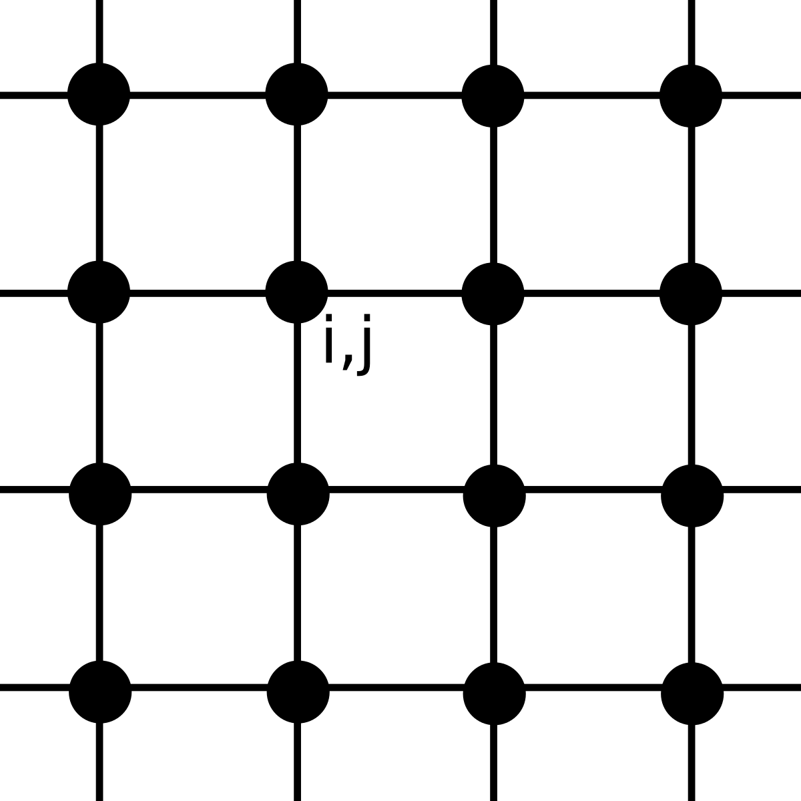
Introduction and Background
Problem description
Solving the problem consists in finding the transfer matrix of this distribution.
This will allow prediction how will the spin system change when some parameter change

Slide 10
Introduction and Background
The one-dimensional Ising model was solved by Ising (1925) himself in his 1924 thesis; it has no phase transition.
The two-dimensional square-lattice Ising model is much harder and was only given an analytic description much later, by Lars Onsager (1944)
Ernst Ising

Slide 11
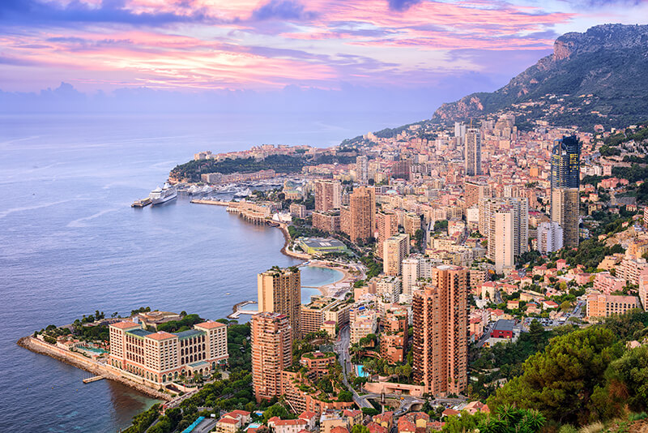
Introduction and Background
Monte Carlo Simulation
Computational algorithms
relay on repeat random sampling to obtain numerical results ..
Used when it’s difficult or impossible to use anther approaches
Our Objective to use one of Monte Carlo Algorithms to solve 2D Ising Model
Monte Carlo, France

Slide 12

Metropolis algorithm
Start
All positive
All Negative
Initiate the grid with one of the initial conditions
Random

Slide 13
Metropolis algorithm
Start
1
-1
-1
1
All positive
All Negative
Initiate the grid with one of the initial conditions
1
1
1
-1
Random
1
-1
1
1
1
1
1
-1
Ex: Random configuration

Slide 14
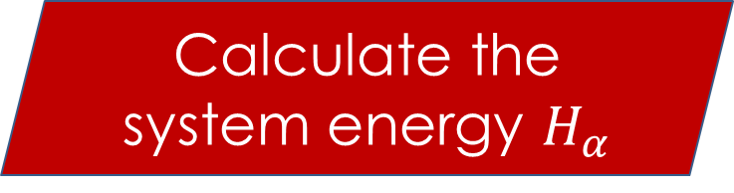
Metropolis algorithm
Initiate the grid with one of the initial conditions
1
-1
-1
1
1
1
1
-1
Calculate the system energy $H_{α}$
1
-1
1
1
1
1
1
-1
Ex: Random configuration

Slide 15


Metropolis algorithm
Calculate the system energy $H_{α}$
1
-1
-1
1
1
-1
1
-1
Pick a random spin {$σ_{k}$}
1
-1
1
1
1
1
1
-1
Ex: Random configuration

Slide 16


Metropolis algorithm
Pick a random spin {$σ_{k}$}
1
-1
-1
1
1
1
1
-1
Try to flip it
$$σ_{ij}={−σ}_{ij}$$
1
-1
1
1
1
1
1
-1
Ex: Random configuration

Slide 17

Metropolis algorithm
Try to flip it
$$σ_{ij}={−σ}_{ij}$$
1
-1
-1
1
1
1
1
-1
Calculate the Change ∆𝐻 according to this change
1
-1
1
1
1
1
1
-1
Ex: Random configuration

Slide 18

Metropolis algorithm
Calculate the Change ∆𝐻 according to this change
1
-1
-1
1
1
1
1
-1
∆𝐻 < 0
Accept the flip
Yes
1
-1
1
1
1
1
1
-1
No
Ex: Random configuration

Slide 19

Metropolis algorithm
∆𝐻 < 0
Accept the flip
Yes
1
-1
-1
1
1
1
1
-1
No
Calculate the probability:
$π_{β}=e^{\frac{−∆H}{K_{β}T}}$
1
-1
1
1
1
1
1
-1
Ex: Random configuration

Slide 20

Metropolis algorithm
Calculate the probability:
$π_{β}=e^{\frac{−∆H}{K_{β}T}}$
1
-1
-1
1
1
1
1
-1
Generate a random Number 0 < a < 1
1
-1
1
1
1
1
1
-1
Ex: Random configuration

Slide 21
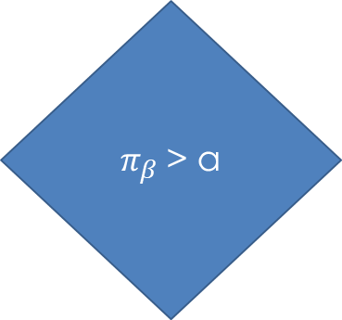
Metropolis algorithm
Generate a random Number 0 < a < 1
1
-1
-1
1
1
1
1
-1
$π_{β}$> a
Accept the flip
Yes
1
-1
1
1
1
1
1
-1
No
Ex: Random configuration

Slide 22

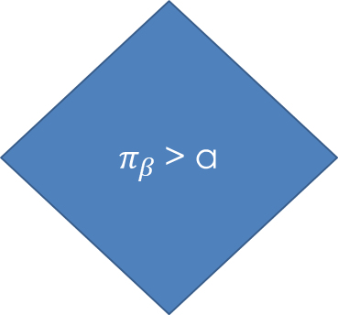
Metropolis algorithm
$π_{β}$> a
Accept the flip
Yes
-1
1
-1
1
1
-1
1
-1
No
1
-1
1
1
Reject the flip and return the value of the flip
1
1
1
-1
Ex: Random configuration

Slide 23


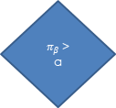

Metropolis algorithm
Try to flip it
$$σ_{ij}={−σ}_{ij}$$
Calculate the Change ∆𝐻 according to this change
1
-1
-1
1
Accept the flip
Yes
∆𝐻 < 0
1
-1
1
-1
For n $≈∞$
No
Calculate the probability:
$π_{β}=e^{\frac{−∆H}{K_{β}T}}$
Generate a random Number 0 < a < 1
1
-1
1
1
$π_{β}$> a
Accept the flip
Yes
1
1
1
-1
No
Reject the flip and return the value of the flip
Ex: Random configuration

Slide 24

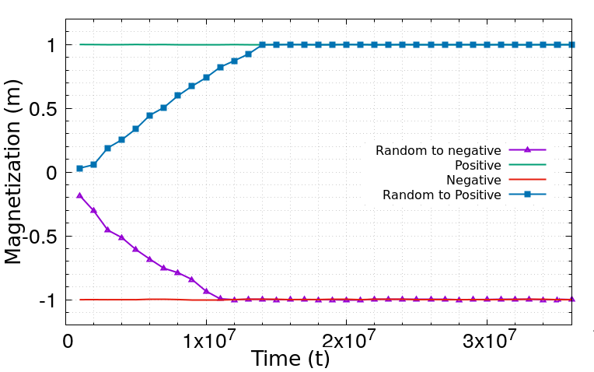
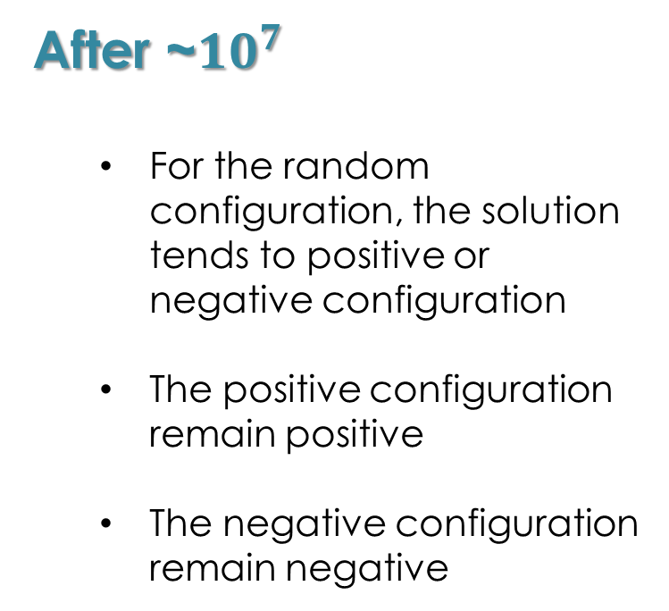
Results & Discussion
After ~${10}^{7}$
For the random configuration, the solution tends to positive or negative configuration
The positive configuration remain positive
The negative configuration remain negative

Slide 25

Results & Discussion
After ~${10}^{7}$

Slide 26
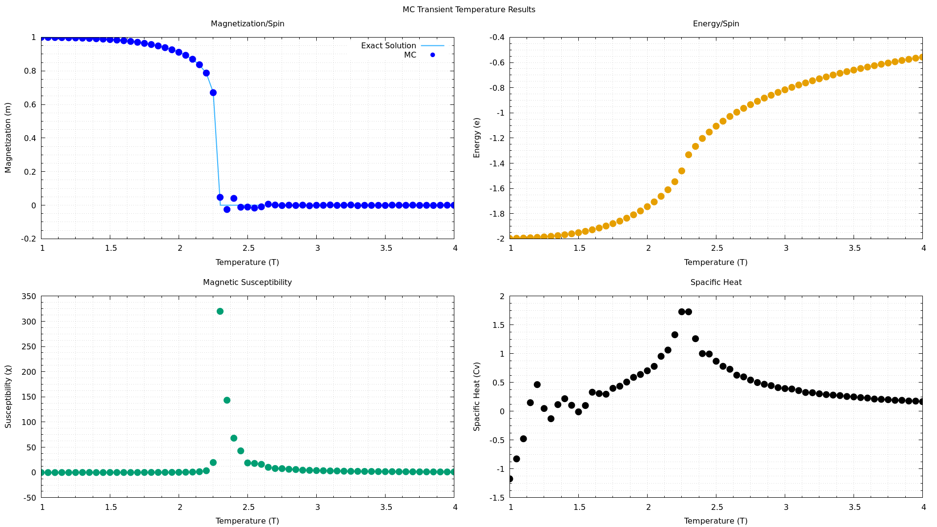
Results & Discussion
Magnetization
Comparison between the exact solution as a function of temperature and Monte Carlo simulation showing a high accuracy

Slide 27
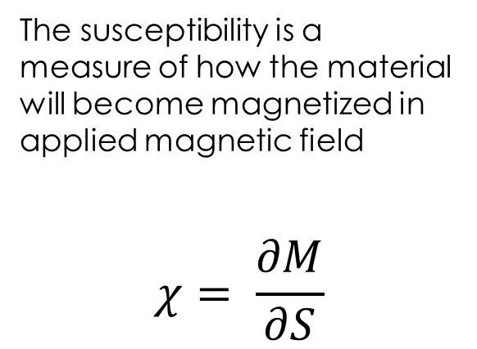
Results & Discussion
the susceptibility
The susceptibility is a measure of how the material will become magnetized in applied magnetic field
$$χ= \frac{∂M}{∂S}$$
magnetization
Magnetic field strength

Slide 28
Results & Discussion
The Energy
The Energy per spin

Slide 29
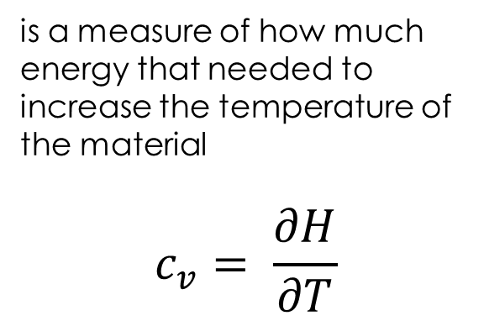
Results & Discussion
The Specific Heat
is a measure of how much energy that needed to increase the temperature of the material
$$c_{v}= \frac{∂H}{∂T}$$

Slide 30

Conclusion
The Numerical results produced are almost the same as the theoretical results
Mont Carlo simulation is valuable and efficient to an exact calculation
There are many related physical problems that can be easily solved by Monte Carlo algorithms (Fluids “Kinetic models of gases and Boltzmann Equation” – disordered materials – strongly coupled solids and cellular structures)

Slide 31

References
[1] Nina Kuklisoving, Solving the 2D Ising Model, PHYS 35200, March 2013
[2] Jacques Kotze, Introduction to Monte Carlo methods for an Ising Model of a Ferromagnet, March 2008
[3] Alexey Khorev, A Monte Carlo Implementation of the Ising Model in Python, August 2017
[4] Wikipedia,Ising Model, https://en.wikipedia.org/wiki/Ising_model, December 2019
Source Code

Slide 32



Thanks for attention
Ahmed Hady
If you have any question don’t hesitate to contact me
+38 (096) 555‐0199
Ahmed.hanfy@intermaths.eu

